Slide 1
Stock Prediction For
Fortune 500
Team Name - Teen Titans GO
Project Repo - https://github.com/ppate460/CS418_Group11
Dimitari Gjorgievski - dgjor2@uic.edu - https://github.com/DimitarGj
Yashwi Shah - yshah33@uic.edu - https://github.com/yshah33
Dona Maria - dmari21@uic.edu - https://github.com/dona10
Janki Patel - jpate305@uic.edu - https://github.com/jpatel114
Pratik Patel - ppate460@uic.edu - https://github.com/ppate460
Notes:
Janki - title and team name

Slide 2

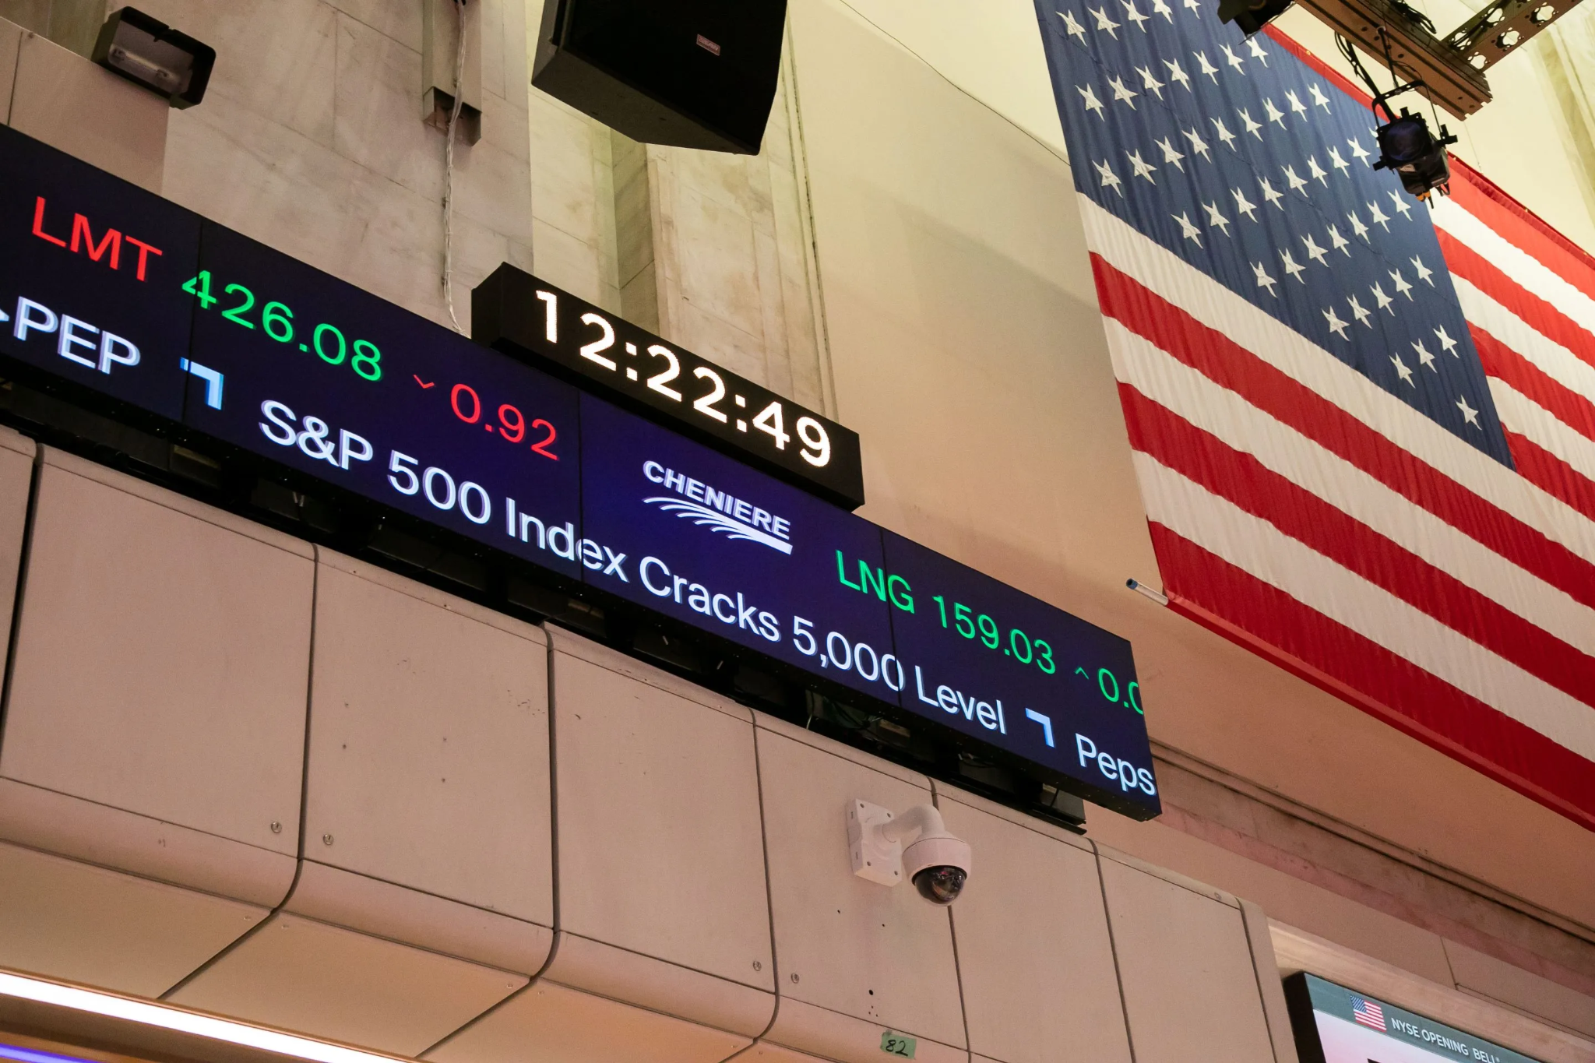
The Problem
Fortune 500 Companies of 2024
Predicting Stock Price
Predicting Revenue
Predicting Profit
Offering Important Insight
Investment Decision
Strategic planning
Risk management
Learning What Drives The Economy
GDP
Unemployment Rate
Inflation
Population
Notes:
Janki - :Hello everyone, I'm Janki. Today, we're looking at how to predict the stock prices, revenues, and profits of Fortune 500 companies in the U.S. This is key because accurate stock predictions empower investors to make wise decisions about whether to buy, sell, or hold—potentially leading to significant financial profits. Also, these predictions play a big role in navigating the risks of an unpredictable market and economic crisis. Businesses also use these insights for planning their strategies, which can impact job availability. Why is this important to all of us? these predictions affect employment, the economy, and our cost of living. Increased spending is correlated with a larger employment market and more opportunities. These companies are of great interest to investors, which makes precise prediction crucial.

Slide 3
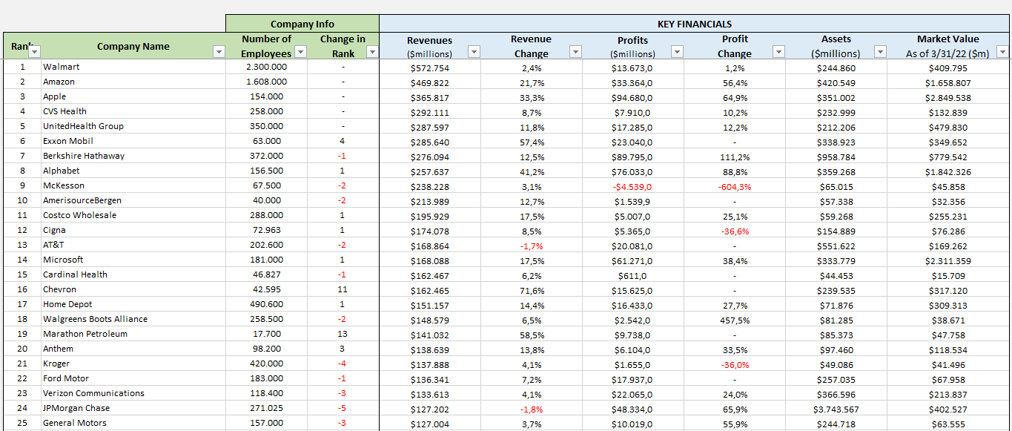
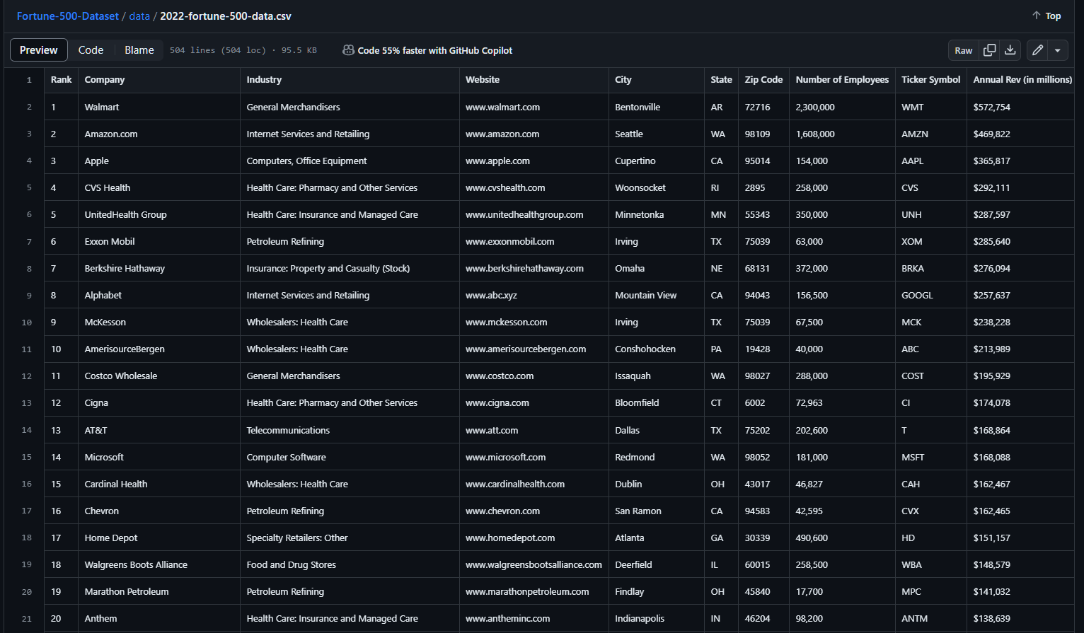
The Data
Data Description:
Data Characteristics:
Web scraping
.csv file (~500 rows)
Financial Databases (Yahoo Finance, Microtend)
Data Type:
Numerical
Categorical (Locations)
Temporal (Timestamp, Trading Volume)
Text/String
Rank Revenue Stock Price Market Cap Trading Volume Debt Levels | Unemployment rate Tax Financial Ratio GDP Profit Earning Per share
Notes:
Yashwi - Data
Now, let’s delve into the data portion, which is pretty much the backbone of our Fortune 500 Companies.
Our dataset covers essential components such as Rank, Revenue, Stock Price, Market Cap, etc, which provide insights into the companies' financial standing and market performance.
We've also incorporated macroeconomic indicators such as Unemployment Rate, Tax, Financial Ratio, and GDP, offering a holistic view.
We also have columns indicating the sector of these companies to analyze which sector performs well in terms of profit by the end of the year.
So, we collected all this Data through web scraping and utilization of financial database websites such as Yahoo Finance and Microtend. These websites are publicly available to anyone.
So here, we are working with various types of data: numerical, categorical, timestamp, and text. As we move forward, this data will help us to analyze and derive meaningful insights in our further findings.

Slide 4
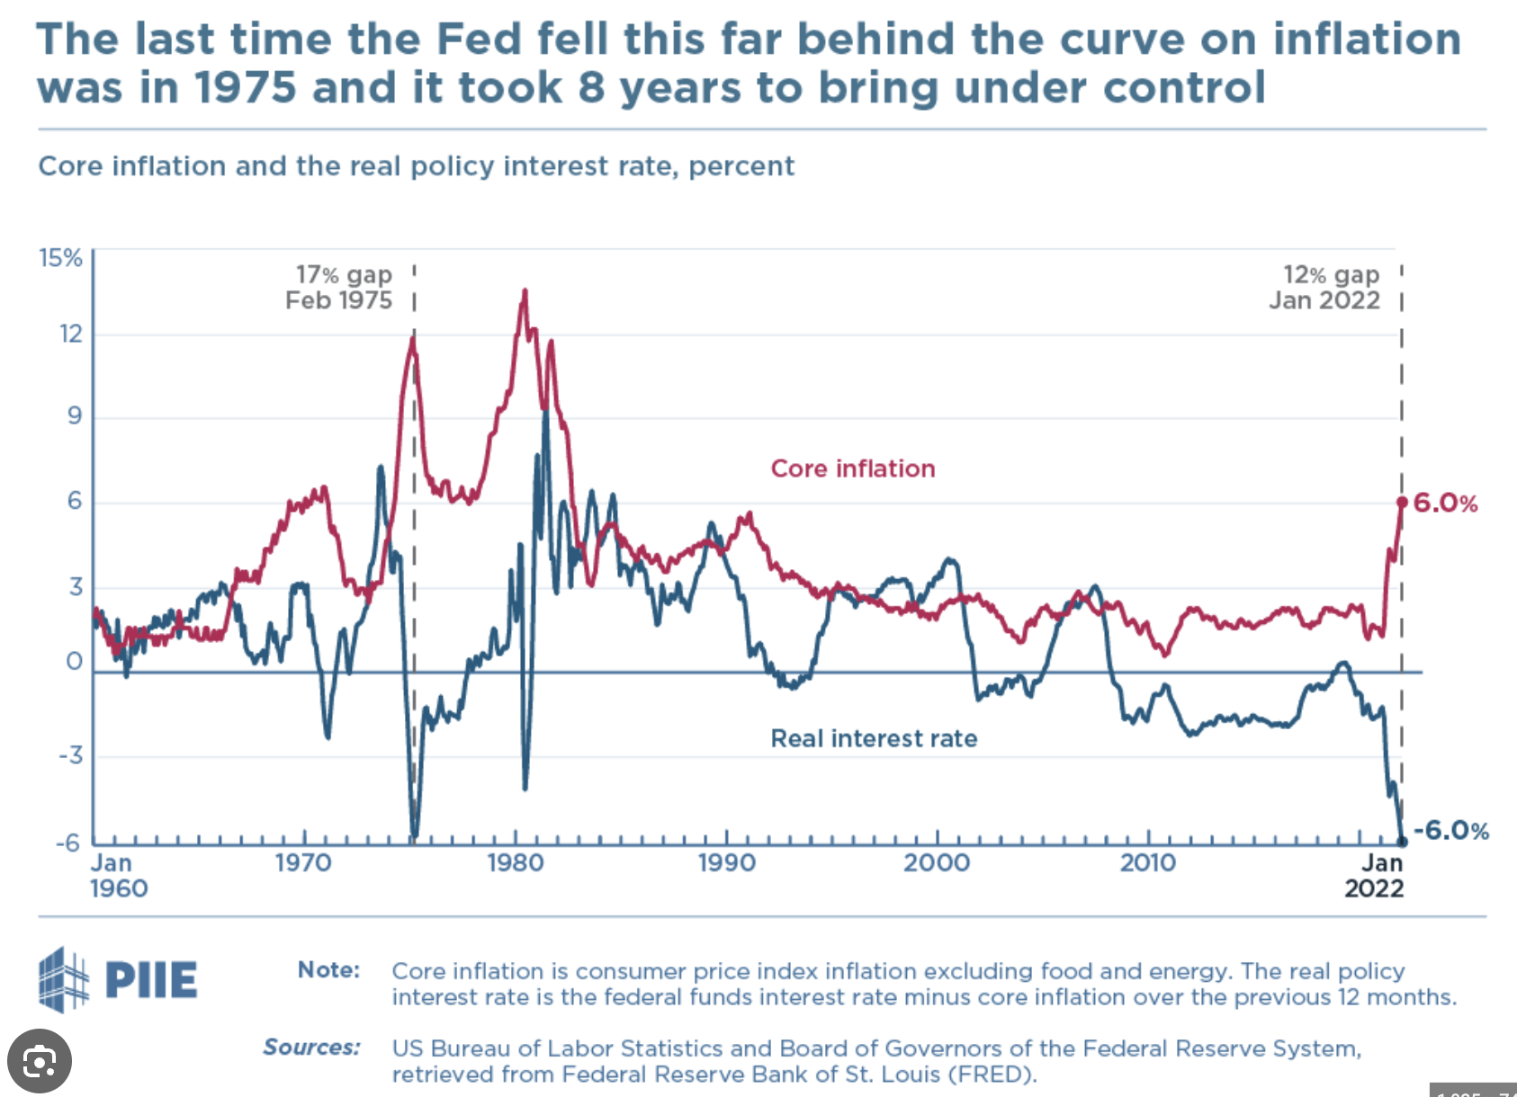
Approaching the Problem
Data Preprocessing:
Handling missing Values
Normalizing
Adjusting to inflation
Data integration
Analyzing Techniques:
Exploratory Data Analysis (EDA)
Trend Analysis
Regression Analysis
Peer Analysis
Fundamental Analysis
Technical Analysis
Machine Learning Model:
Predict stock prices
Predict ranking of fortune 500
Predict recession probability
Inverse relationship between Inflation and Interest rate
Notes:
Dona - Approaching the Problem
We are gonna tackle the problem by starting with the data preprocessing steps to ensure the data is clean organized and ready for analysis.
This step involves handling missing values by using the imputation and deletion method.
Normalizing data to prevent one feature dominating the whole analysis. Additionally we need to adjust the data to account for inflation and
last data integration as we are using multiple datasets.
After we are done with the data preprocessing methods, we are gonna conduct various analysis to examine trends, patterns, relationships and performance. This makes us to provide a better understanding of the data.
Lastly we are gonna utilize machine learning models to predict the stock prices, ranking of the 500 companies and the probability of recession happening.

Slide 5
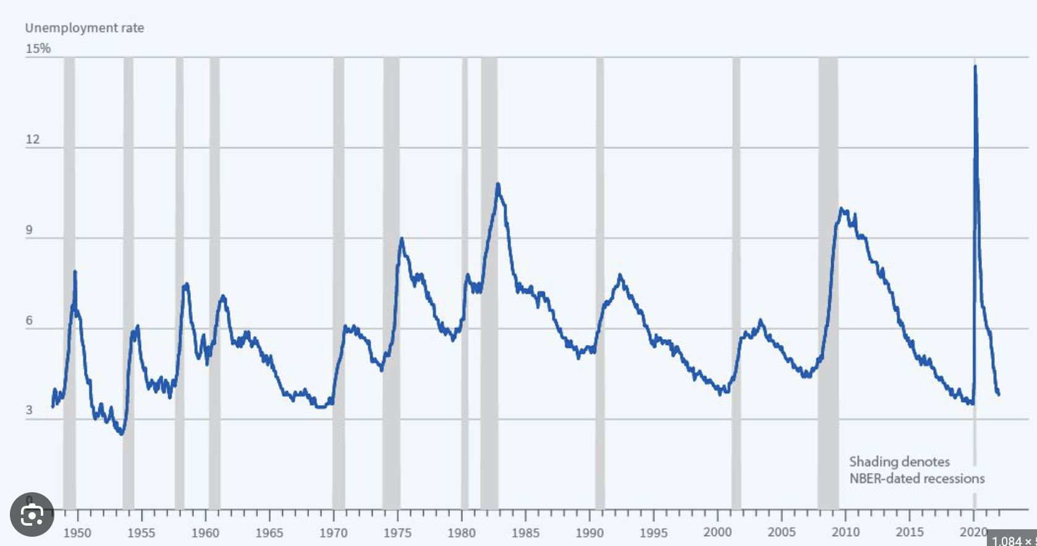
Expected Results
The goal of this project is to correctly output the stock price of each fortune 500 companies and their ranking by the end of the year 2024
Our model reflect given data and make a prediction which then applies those trends to predict future outcome.
The user/audience would be able to customize the predictability of the outcome of a specific data.
Envision System (Interactive or Static) ?
Visualization of data tends
Customize specific parameter
Real time data updates
Adaptive User Interface
Achievements for the progress report:
Based on the history, everytime the unemployment goes up, there is a sign of short/long recession.
Our model can predict of what is a likelihood of having recession in near future based on the unemployment data.
Unemployment Rate vs Recession predictability
Notes:
Dimitari & Pratik - Expected Results
Our ultimate goal is to experiment with different machine learning models that will predict the stock price of each company, their profits and revenue. Our aim is for our model to effectively find the trends and patterns that lead to the result of each target variable. With this we are hoping that our model will learn the sufficient parameters and find the correct trends in order to achieve sufficient prediction accuracy and give us a hint to what the future holds for the companies in our database. We are also looking to give the user the option to look into more detailed data for companies of their interest.
Pratik: Our model is going to be interactive where it lets user select different parameters and visual the trends in the market. Based on parameters selected by the user, a chart will be presented where you can see the clear relationship between those parameters and the what is the future prediction of how the overall market is going to perform. For example, you can see in graph on the screen, there is a clear trend occuring, everytime the unemployment goes up, there is a sign of short/long term recession. Our model will provide very similar concept + what is the trend in the future. So that economists take better decisions based on it.

Slide 6
Data sources
Historical Stock Price : https://finance.yahoo.com/quote/WMT/history
2022 + 2023 + Company Info : https://github.com/EatMoreOranges/Fortune-500-Dataset/tree/main/data
Revenue + Profit (1955-2019) : https://github.com/cmusam/fortune500
Revenue + Tax + Profit : https://www.macrotrends.net/stocks/charts/AAPL/apple/income-statement?freq=Q
Unemployment Rate + GDP change : https://github.com/ngupta23/gdp_prediction/blob/master/data/archived/economic_indicators_all.csv

Slide 7


